Slide 1

Malla Reddy Engineering College
(An UGC Autonomous Institution, Approved by AICTE, New Delhi & Affiliated to JNTUH, Hyderabad).
Accredited by NAAC with ‘A++’ Grade (Cycle-III), Maisammaguda(H), Medchal - Malkajgiri District, Secunderabad, Telangana State – 500100, www.mrec.ac.in
Department of B.Tech AIML
Major Project Review
Presentation on
GOLD PRICE PREDICTION:A COMPARATIVE ANALYSIS OF ML AND TIME SERIES MODELS
Team Members
Under the Guidance of
C.Dasaratha RamiReddy (21J41A7318)
N.Anvitha (21J41A7308)
Riyaz Khan (21J41A7351)
Ms.M.Santhosha
Assistant professor

Slide 2
ABSTRACT
Our project focuses on predicting the price of Gold ETFs based on historical market data. Previous approaches, such as linear regression, have been widely used to forecast gold prices. However, linear regression is limited by its assumption of a linear relationship between the input features and the target variable. This approach often fails to capture complex, non-linear relationships in financial data, leading to lower prediction accuracy and poor generalization in volatile markets. In contrast, this project uses the Random Forest Regressor, an ensemble machine learning algorithm, to overcome these limitations. The model achieves better forecasting results, as shown by higher accuracy of 90%, compared to the typical range of 80% seen with linear regression, and reduced error rates. The system works by first analyzing historical gold price data, extracting relevant features, and training the Random Forest model to predict future gold prices. The predictive power of Random Forest allows investors to make more informed decisions when buying or selling gold. The increased model accuracy proves the effectiveness of this approach.

Slide 3
PROBLEM STATEMENT
Gold has long been regarded as a safe-haven asset, and its price fluctuations are of critical interest to investors, policymakers, and economists. However, predicting gold prices is a complex task due to the influence of various economic factors and market sentiments. This project aims to develop a machine learning model to predict the future price of gold based on historical data. By leveraging a Random Forest Regressor, this study seeks to provide a reliable forecasting model that can assist in making informed decisions in the financial markets and enhance understanding of gold price dynamics.

Slide 4
OBJECTIVE
Our project is to develop an advanced machine learning model, using the Random Forest Regressor
Enhance Prediction Accuracy Using Random Forest
Enhanced Decision-Making
To identify key features influencing gold price fluctuations

Slide 5
LITERATURE SURVEY
Sami & Junejo (2017) used ANN to predict gold prices with inputs like oil prices, S&P 500, and USD rates, effectively modeling non-linear economic relationships.
Navin & Vadivu (2013) applied Decision Tree for feature selection and SVR for accurate predictions using market data like open, close, high, low, and volume.
Rebecca Davis (2014) applied the Autoregressive Moving Average (ARMA) model to forecast gold prices using monthly data spanning ten years. The model, commonly used for time series analysis, achieved an accuracy of 66.67%, highlighting its moderate effectiveness in capturing gold price trends.
Patil et al. (2016) used SVM and Logistic Regression with factors like silver, copper, oil, EUR/USD, and S&P/TSX; Logistic Regression performed better with 61.92% accuracy.

Slide 6
EXISTING SYSTEM
The existing system for Gold Price Prediction relies on Linear Regression, which has several limitations. First, it assumes a linear relationship between the input features and the target variable, making it ineffective in capturing non-linear relationships in complex data scenarios. Additionally, Linear Regression is prone to overfitting when there are too many predictors or noise in the data. Moreover, it struggles with real-time data processing and is heavily dependent on a limited set of variables, reducing its ability to handle dynamic market conditions and produce accurate predictions in real-world scenarios.

Slide 7
DISADVANTAGES
Assumes a Linear Relationship: Linear regression assumes a straight-line relationship, limiting its ability to model complex, non-linear market behavior.
Struggles with Non-linear Relationships: It fails to capture non-linear patterns in data, resulting in lower accuracy when predicting volatile gold prices.
Overfitting in Complex Datasets: Linear regression is prone to overfitting, especially with noisy or high-dimensional data, reducing its generalization capability.
Limited Real-Time Data Processing: The model struggles to handle real-time data and adapt to rapid market changes without retraining.
Dependency on Limited Variables: It relies on a limited set of features, neglecting potentially important variables that could improve prediction accuracy.

Slide 8
PROPOSED SYSTEM
The proposed system analyzes the correlations between a wide range of financial assets, including U.S. stocks (SPX), precious metals like gold and silver (GLD, SLV), crude oil (USO), and the EUR/USD exchange rate. By examining real-time data from these assets, the system enables investors to assess risk, track market trends, and optimize portfolio diversification. It helps identify how fluctuations in oil prices, gold, and silver prices impact stock markets, or how the strength of the dollar influences global assets. This solution addresses the common drawbacks of traditional models, such as delayed market reactions, limited understanding of cross-asset correlations, and overwhelming data streams. By providing real-time predictive analytics and a more comprehensive, multi-asset perspective, the system allows for faster and more accurate decision-making, especially during volatile market conditions. It improves the accuracy of predictions and streamlines complex financial analysis, offering a clear advantage over conventional static approaches.

Slide 9
ADVANTAGES
Enhanced Decision-Making: The system provides detailed insights and real-time data analysis, enabling investors to make informed decisions based on comprehensive market conditions.
Predictive Capabilities: By leveraging advanced analytics and machine learning, the system can forecast trends and market movements, helping investors anticipate market changes ahead of time.
Integrated Market Data: It consolidates data from multiple asset classes, such as commodities, currencies, and stocks, giving a holistic view of the market for more strategic investment planning.
Increased Efficiency: Automated data processing and analysis reduce the time required for research, allowing investors to respond to market changes more quickly and efficiently.

Slide 10
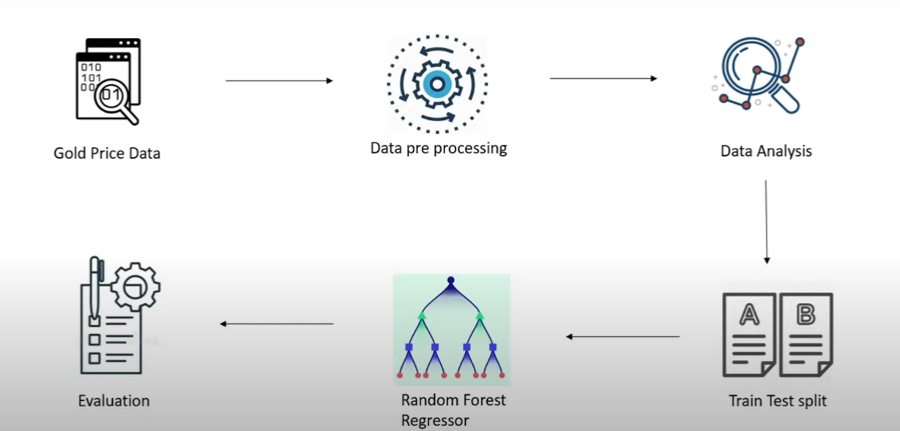
SYSTEM ARCHITECTURE

Slide 11
HARDWARE &SOFTWARE REQUIREMENTS
HARDWARE REQUIREMENTS:
Processor: Intel Core i5 or higher
Storage: At least 256 GB SSD
RAM: Minimum 8 GB
Operating System: Windows 10/11, macOS, or Linux (Ubuntu preferred for Python environments)
SOFTWARE REQUIREMENTS:
Programming Language: Python 3.x
IDE/Editor:Jupyter Notebook
Libraries/Packages: Panda,Numpy,Matplotlib,scikit-learn,xgboost

Slide 12
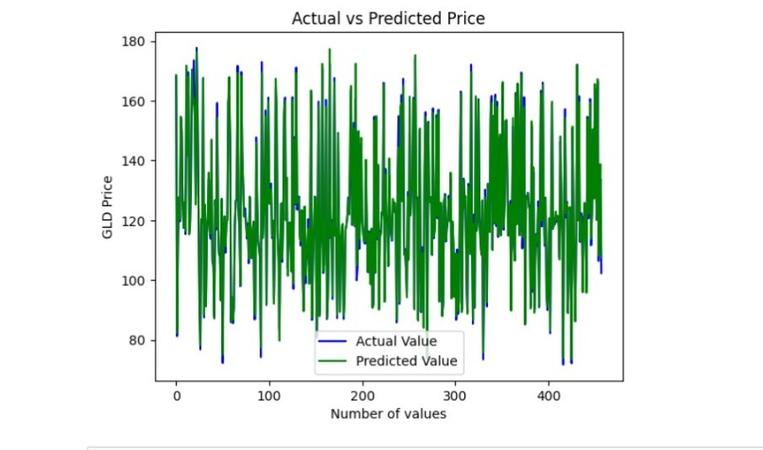
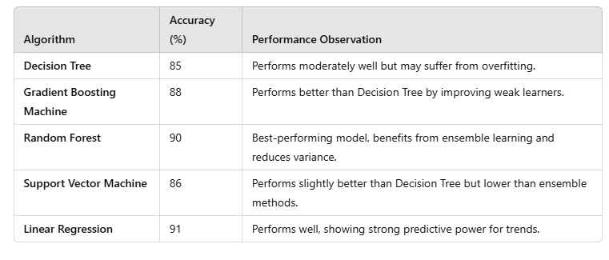
RESULTS

Slide 13
FUTURE ENHANCEMENT
Incorporate real-time data feeds to enable live gold price predictions.
Implement deep learning models such as LSTM or GRU for improved time-series forecasting.
Expand feature sets to include global economic indicators like interest rates, inflation, and geopolitical events.

Slide 14
CONCLUSION
Gold price prediction is a complex task influenced by various economic, financial, and geopolitical factors. In this machine learning techniques such as Linear Regression, Random Forest Regressor, and were employed to predict gold prices using historical data. Among these, the Random Forest Regressor demonstrated the highest accuracy, indicating its effectiveness in handling non-linear relationships and large feature sets. The results highlight the potential of machine learning models in making reliable financial forecasts. With further enhancements like real-time data integration, deep learning models, and user-friendly interfaces, the system can be developed into a powerful tool for investors and analysts

Slide 15
Thank You!

